Slide 1
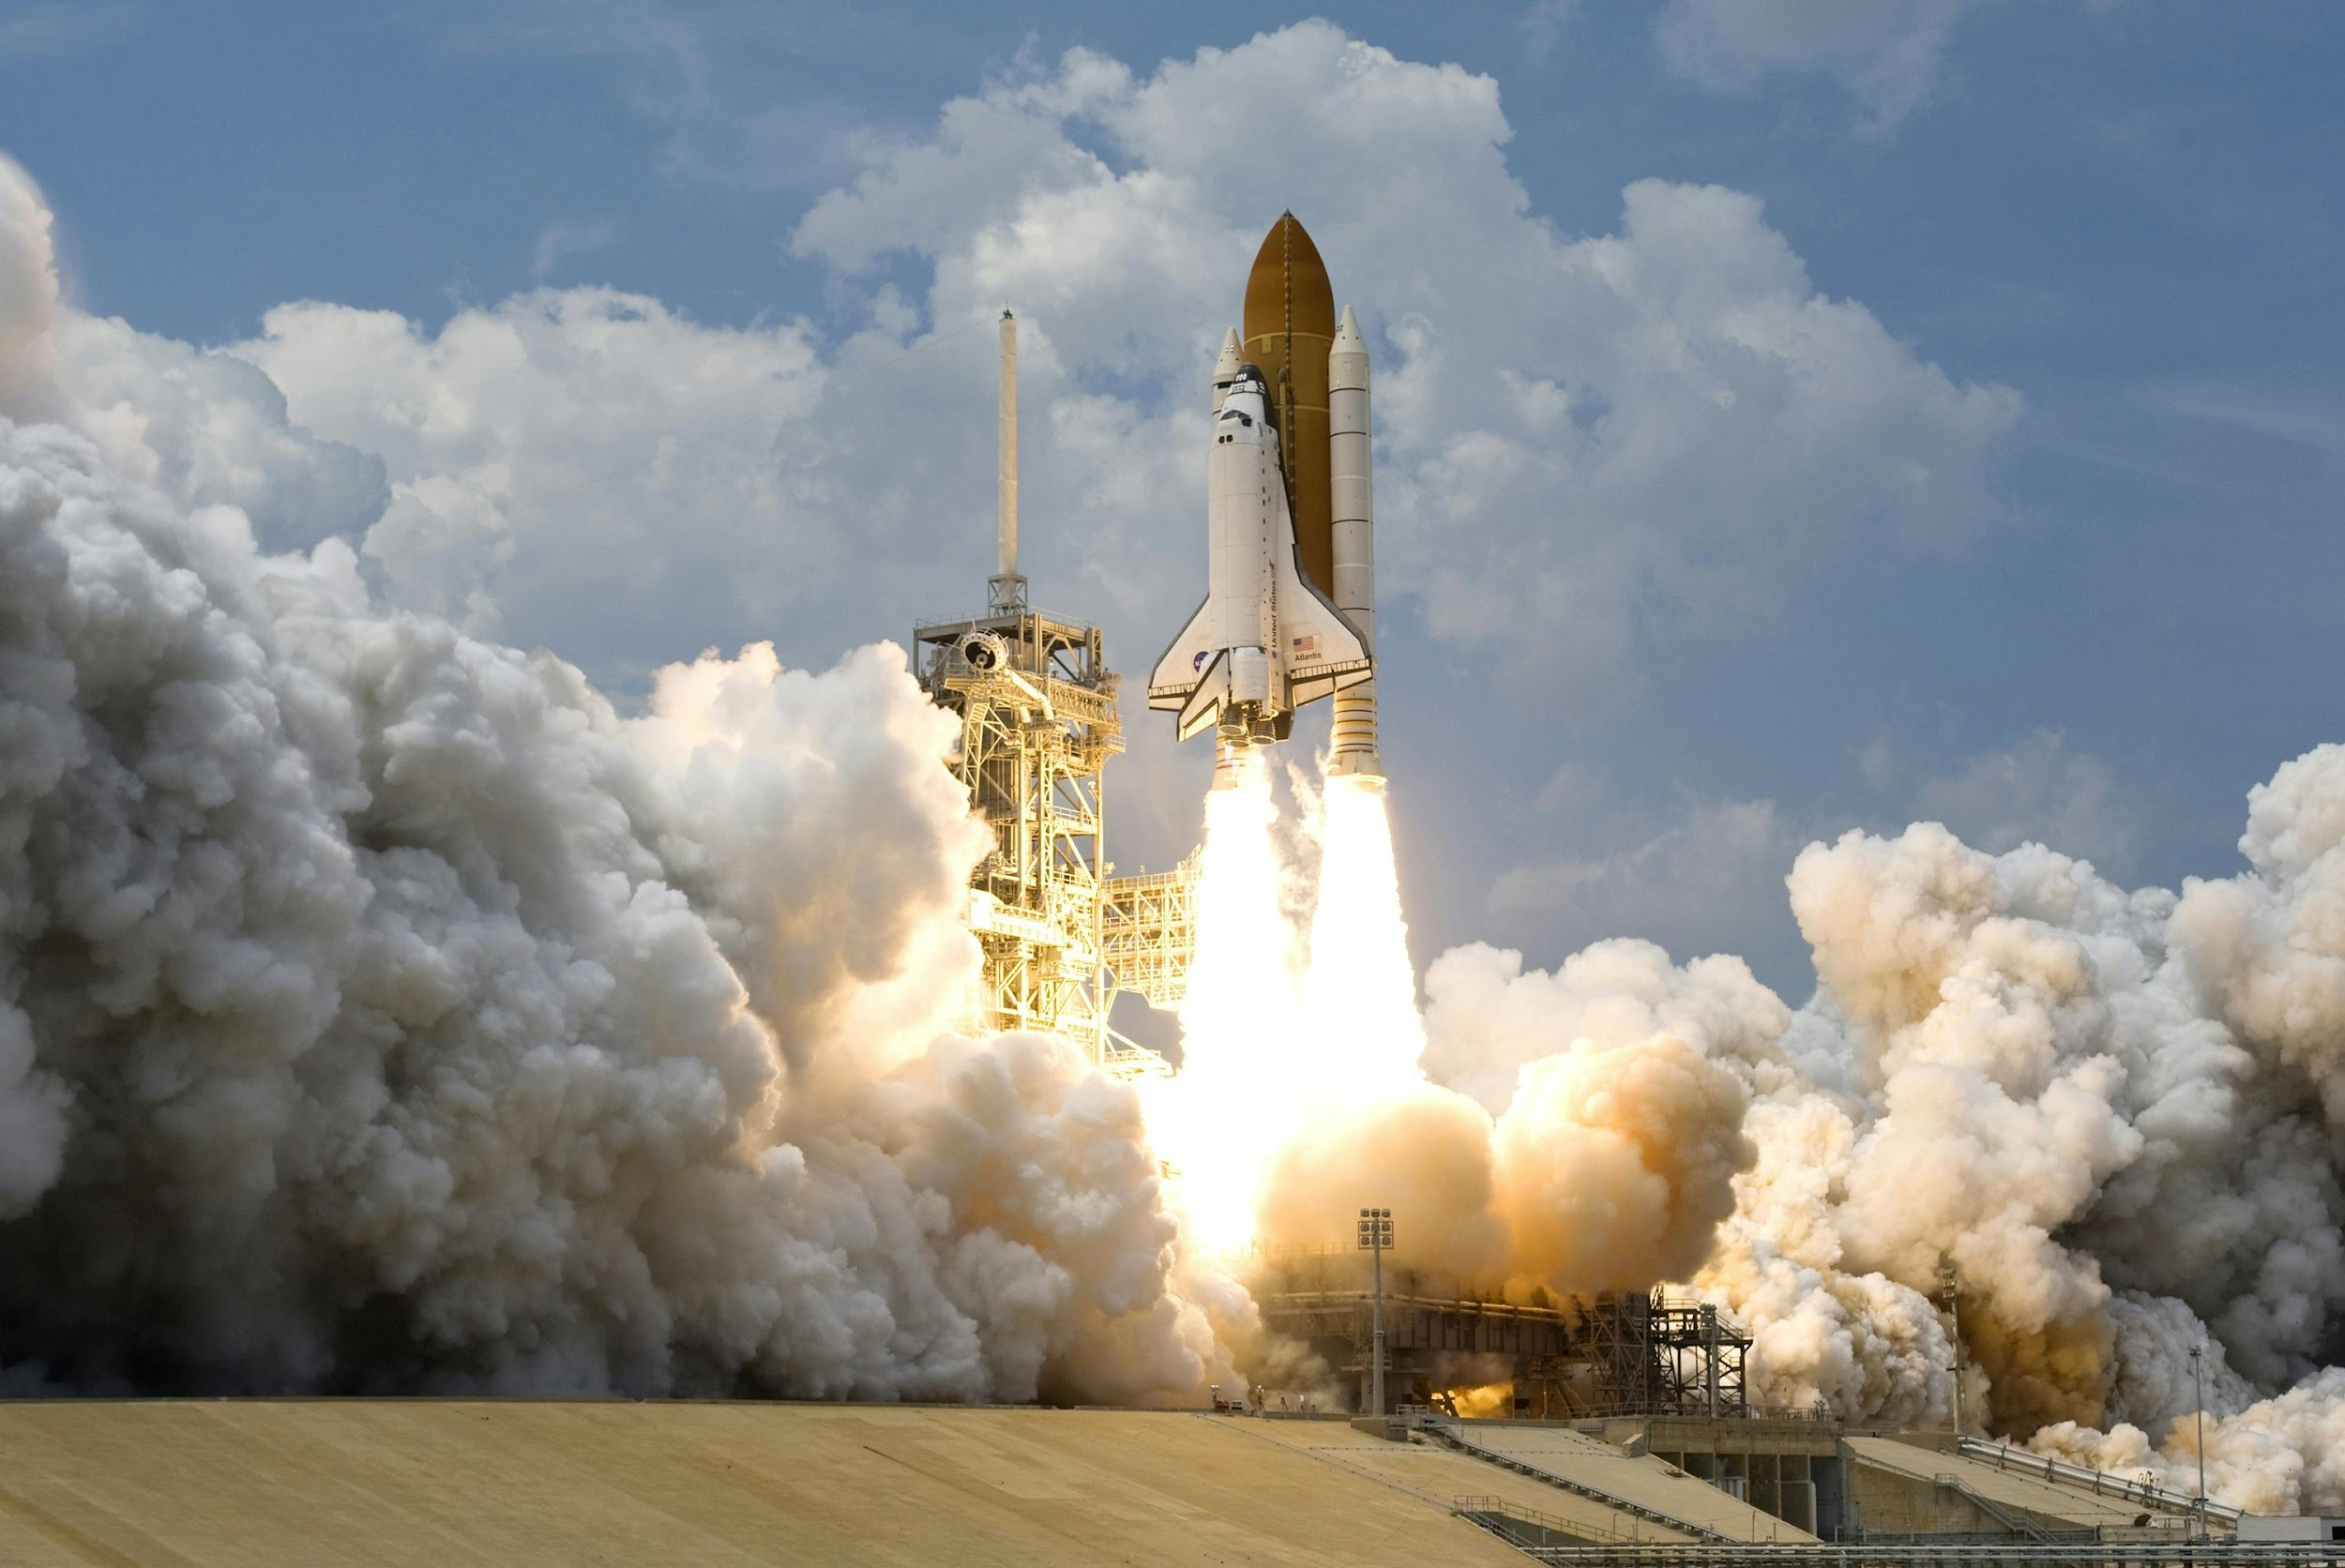
SpaceY Project
Gabriel Silva de Melo
27/09/2024

Slide 2

Outline
Executive Summary
Introduction
Methodology
Results
Conclusion
Appendix

Slide 3
Executive Summary
Summary of Methodologies
Data collection with SpaceX API and web scraping.
Data wrangling to transform the data and make it better for analysis.
Turning data into a dataframe for exploration.
Data analysis for finding useful information.
Data visualization with plots and charts.
Predictive analysis using machine learning models.
Summary of results
Launching tends to improve over time.
All launch sites are near the cost.
The booster F9 v1.1 has an average payload of 2534.66
Most ML models tested had the same accuracy, only Decision Trees performed slightly better.

Slide 4
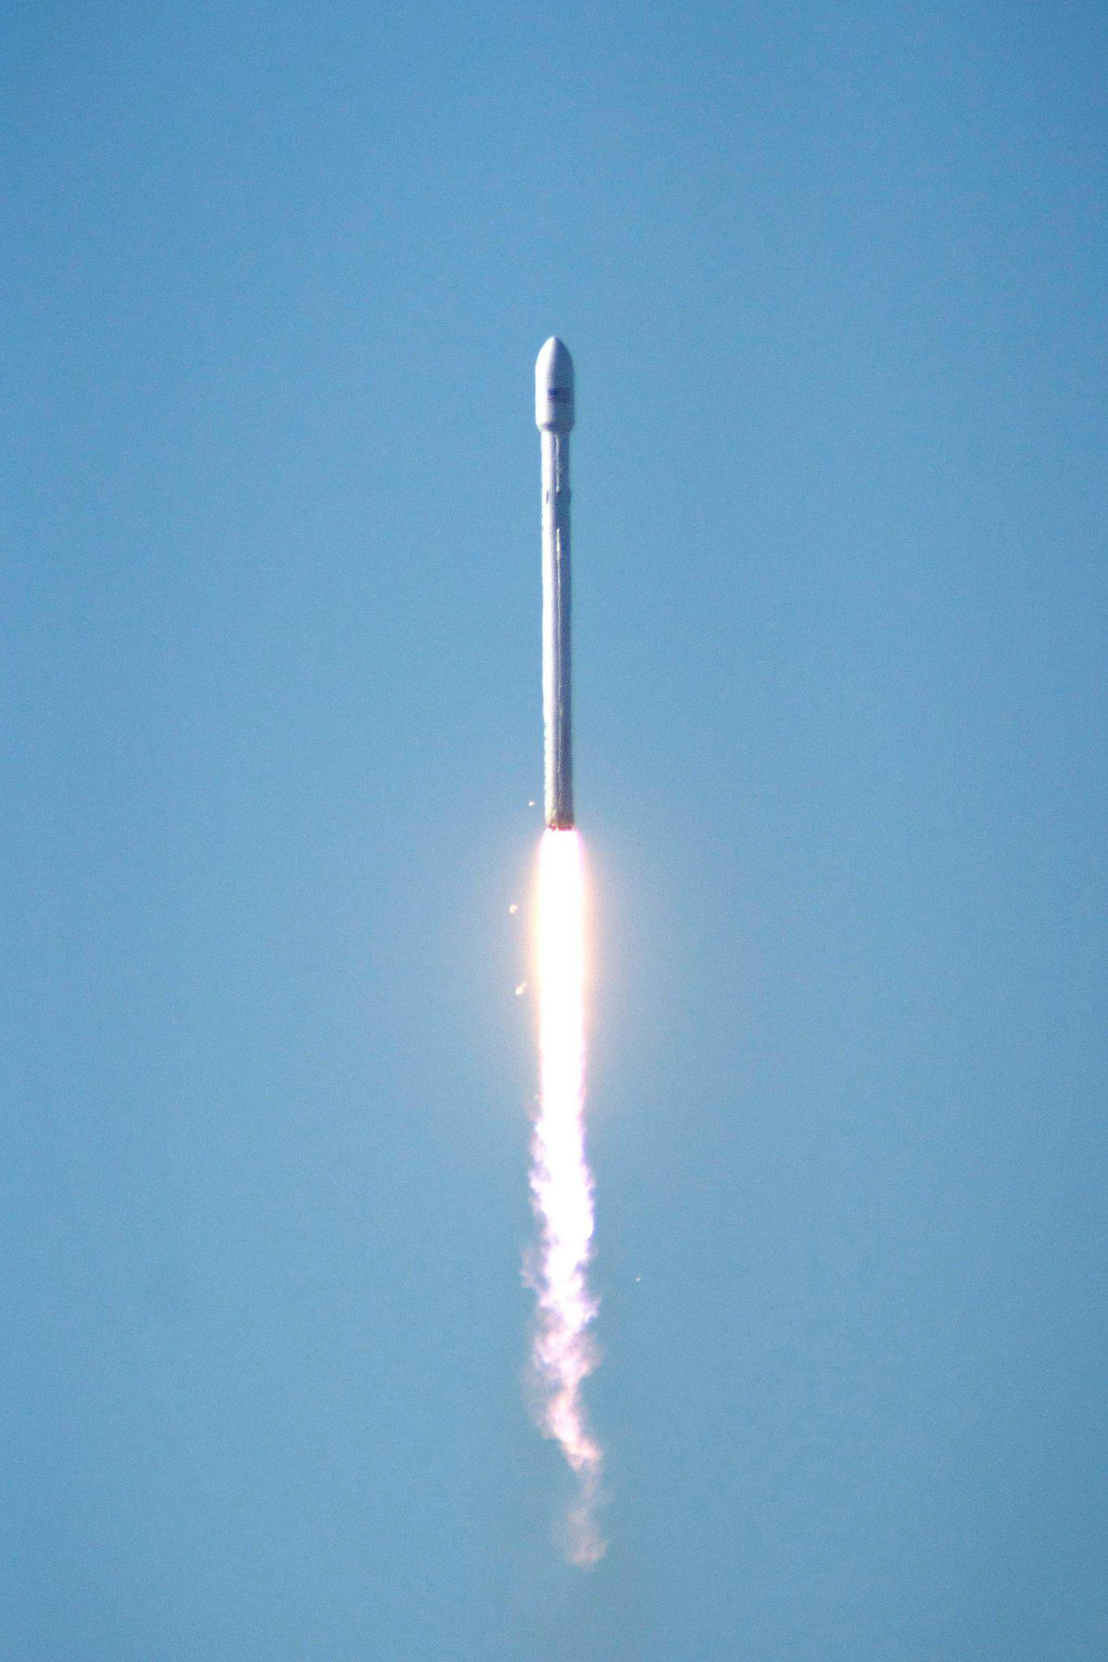
Introduction
SpaceX can make rocket launching cheaper than other companies since they can reuse the first stage. The goal of this project is to predict when the landing of the first stage will be successful.
Explore
Discover how variables like payload, orbit, launch site and number of flights affects the rate of success of first stage recovery.
Find the best model to predict the outcome of the mission.

Slide 5

Section 1
Methodology

Slide 6
Methodology
Data collection: SpaceX API and web scraping on wikipedia.
Data wrangling: Pandas and Numpy were used to clean the data and to create a new ‘Class’ column to make it possible to use it as a dependent variable for the ML models.
Exploratory data analysis (EDA): SQL was used to find key information on the data, plots were also used to find correlation on the data.
Interactive visual analytics: Folium was used to build interactive maps and pinpoint launch sites on the map, also, Dash was used to display charts in a interactive way.
Predictive analysis: Scikit Learn was used to build and train ML models using the available data, looking to predict the ‘Class’.

Slide 7
Data Collection
The Data collection process involved using the SpaceX API and also some web scraping on the wikipedia page using requests and Beautifulsoup.

Slide 8
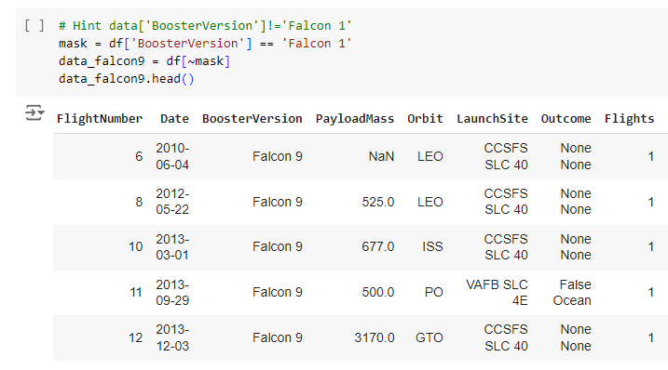
Data Collection – SpaceX API
Collecting data from the SpaceX API involved making a request to the API, which returned a json file that was opened with pandas to make possible retrieving the data.
This data was added to several lists that later became the Data Frame used for the project.
Data was filtered so that the dataframe only contained Falcon 9 data.
https://github.com/awesomegab/IBM-DS-Capstone/blob/main/01%20Data%20Collection%20API%20notebook.ipynb

Slide 9
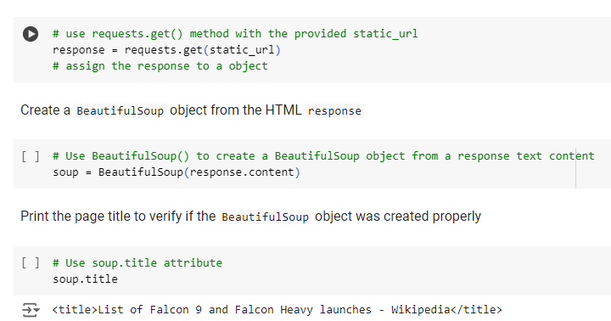
Data Collection - Scraping
Request and Beautifulsoup were used to web scrape a table about SpaceX from a Wikipedia page.
After scraping data was turned into a pandas dataframe.
https://github.com/awesomegab/IBM-DS-Capstone/blob/main/02%20Data%20Collection%20Web%20Scrapping.ipynb

Slide 10
Data Wrangling
Data needed to be processed because there were NaN values, these were replaced by the average of the columns they were in.
A new column was created to better fit the model used to predict the outcome of the launch.
At this part we were able to see how many null values there were and also see the number of launches per launch site.
https://github.com/awesomegab/IBM-DS-Capstone/blob/main/03%20Data%20wrangling.ipynb

Slide 11
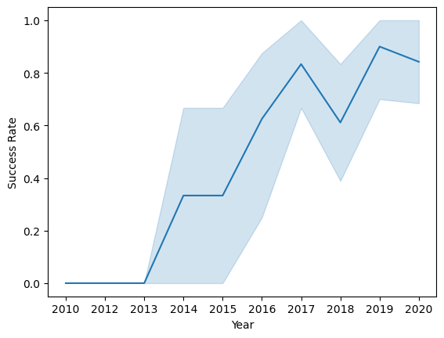
EDA with Data Visualization
Visualization was used to see the correlation of variables and also to find out how the success rate of rocket launches is increasing.
https://github.com/awesomegab/IBM-DS-Capstone/blob/main/04%20Exploring%20and%20Preparing%20Data.ipynb

Slide 12
EDA with SQL
SQL was used to find information such as:
Unique launch sites.
Records for launch site ‘CCA’.
Total payload carried by boosters launched by NASA
Average payload carried by booster version F9 v1.1
and more.
https://github.com/awesomegab/IBM-DS-Capstone/blob/main/05%20SQL%20EDA%20notebook.ipynb

Slide 13
Interactive Map with Folium
Folium was used to create interactive maps and mark the locations of the launch sites, making it possible to see that launch sites are always located near the coast and that most launch sites are near the Equator line.
Also distance from the nearest city, railway and roadway were measured using the Folium map.
https://github.com/awesomegab/IBM-DS-Capstone/blob/main/06%20Locations%20Analysis%20with%20Folium.ipynb

Slide 14
Dashboard with Plotly Dash
Pie chart with successful launches for each launch site.
Slider of paymass.
Scatter plot of payload vs success rate.
https://github.com/awesomegab/IBM-DS-Capstone/blob/main/07%20spacex_dash_app.py.txt

Slide 15
Predictive Analysis (Classification)
Several Scikit learn models were utilized to predict ‘Class’ column, all combined with GridSearchCV.
Logistic Regression
Support Vector Machine
Decision Tree
K-Nearest Neighbor
https://github.com/awesomegab/IBM-DS-Capstone/blob/main/08%20Machine%20Learning%20Prediction.ipynb

Slide 16
Results
Launching tends to improve over time.
All launch sites are near the cost.
The booster F9 v1.1 has an average payload of 2534.66
Most ML models tested had the same accuracy, only Decision Trees performed slightly better.

Slide 17

Section 2

Slide 18
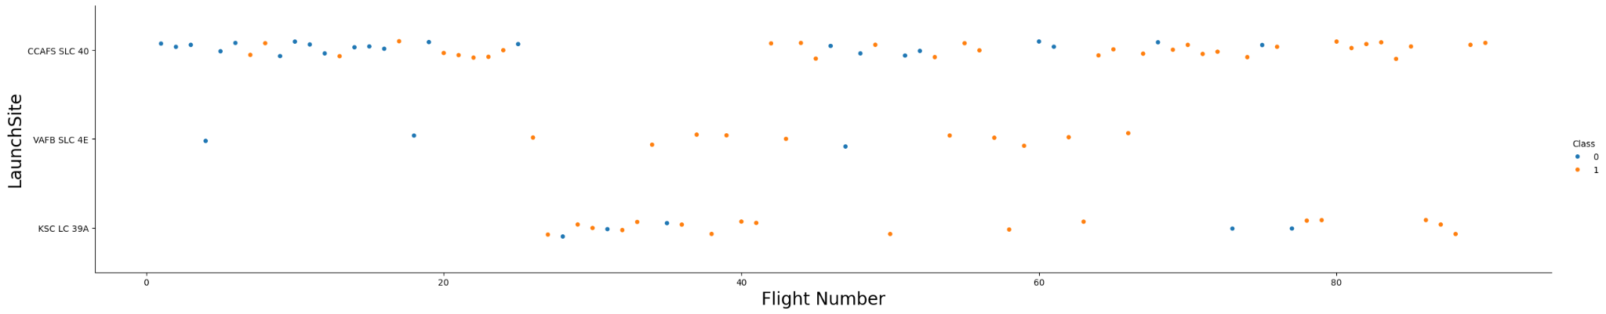
Flight Number vs. Launch Site
Blue points = failure
Orange points = success

Slide 19
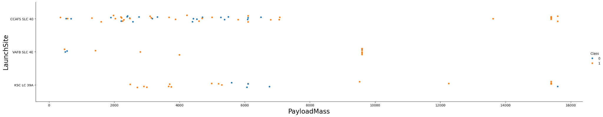
Payload vs. Launch Site
Blue points = failure
Orange points = success

Slide 20
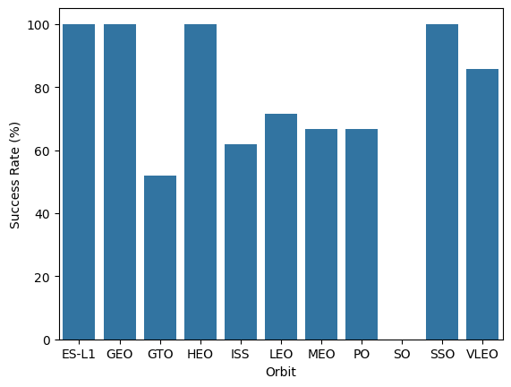
Success Rate vs. Orbit Type
Note that some orbits have 100% of success rate.

Slide 21
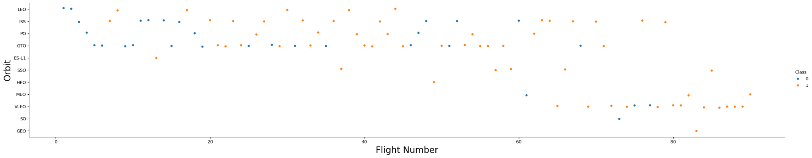
Flight Number vs. Orbit Type
Blue points = failure
Orange points = success

Slide 22
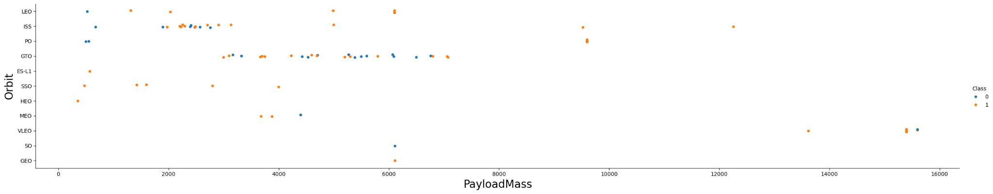
Payload vs. Orbit Type
Blue points = failure
Orange points = success

Slide 23
Launch Success Yearly Trend
Note that success rate has increased massively since 2013.

Slide 24
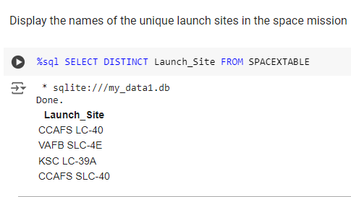
All Launch Site Names
Retrieving the names of the launch sites:

Slide 25
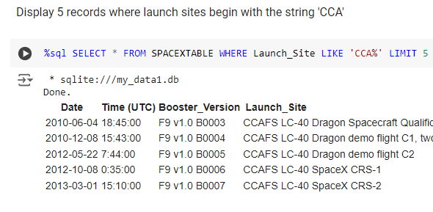
Launch Site Names Begin with 'CCA'
Retrieving records from a specific launch site:

Slide 26
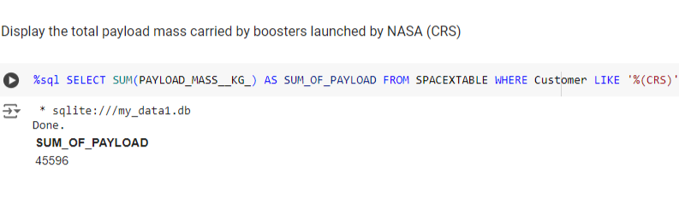
Total Payload Mass
Retrieving the sum of payload carried by boosters launched by NASA:

Slide 27
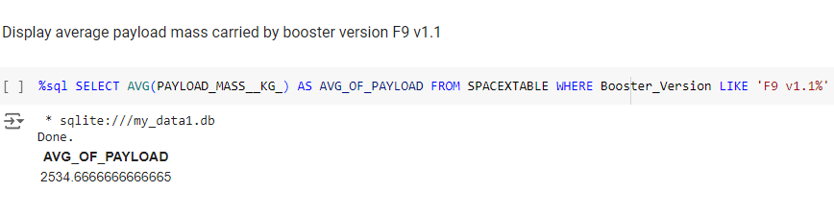
Average Payload Mass by F9 v1.1
Retrieving the average payload for booster version F9 v1.1:

Slide 28
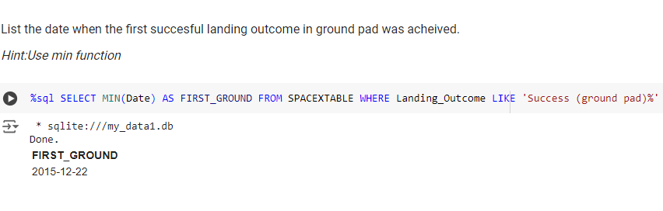
First Successful Ground Landing Date
Retrieving the date of the first successful landing:

Slide 29
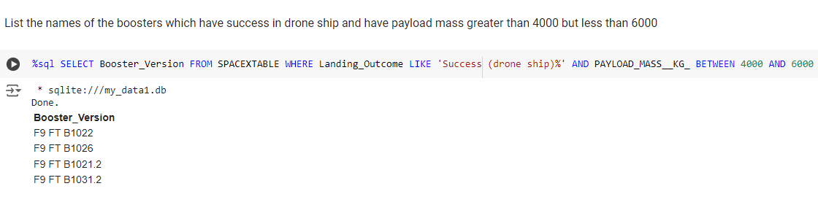
Successful Drone Ship Landing with Payload between 4000 and 6000
Retrieving the list of booster that had success with greater payloads:

Slide 30
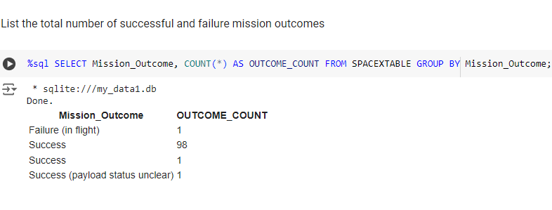
Total Number of Successful and Failure Mission Outcomes
Total outcome:

Slide 31
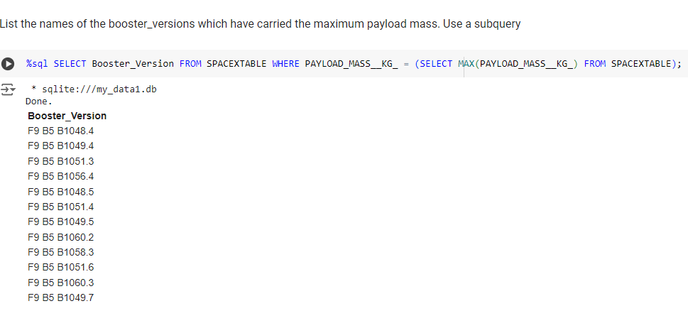
Boosters Carried Maximum Payload
Boosters which carried the max payload:

Slide 32
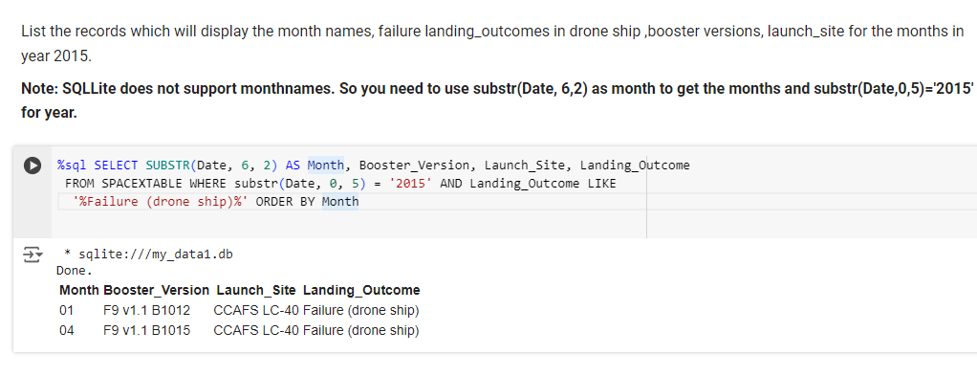
2015 Launch Records
2015 launches:

Slide 33
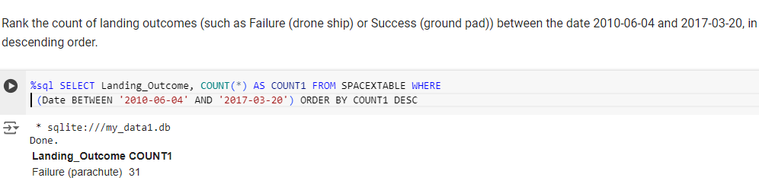
Rank Landing Outcomes Between 2010-06-04 and 2017-03-20
Landing outcomes:

Slide 34

Section 3

Slide 35

Folium Map Screenshot
All launch sites marked on the map:

Slide 36

Folium Map outcomes
Successful outcomes marked as green and failed as red:

Slide 37

Folium Map measuring distance
Distance calculated from launch site to coast:

Slide 38

Section 4

Slide 39
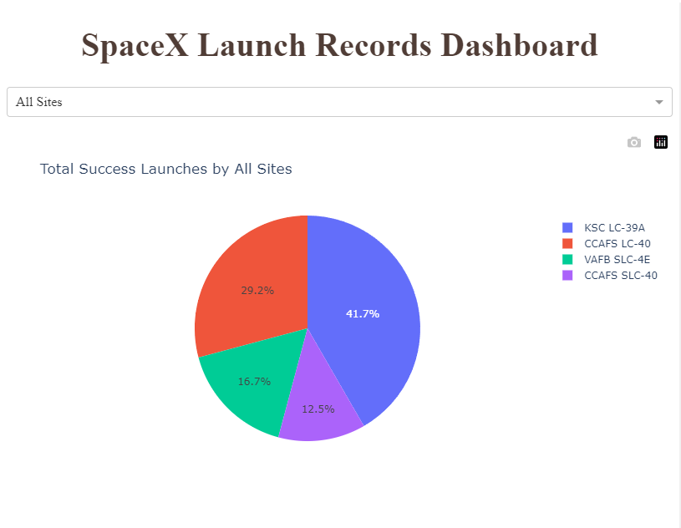
Dash dashboard
Successful launches:

Slide 40
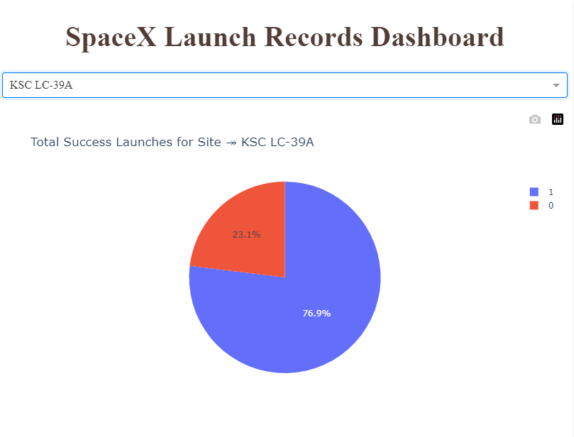
Dashboard highest launch rate
KSC LC-39A has the highest success rate among launch site:

Slide 41
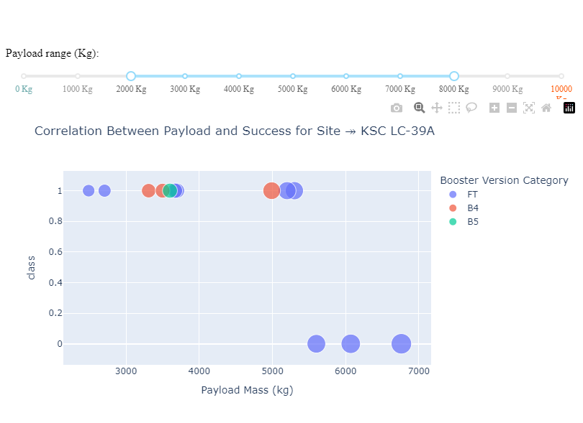
Dashboard scatter
Scatter plot showing correlation between payload mass and success:

Slide 42

Section 5

Slide 43
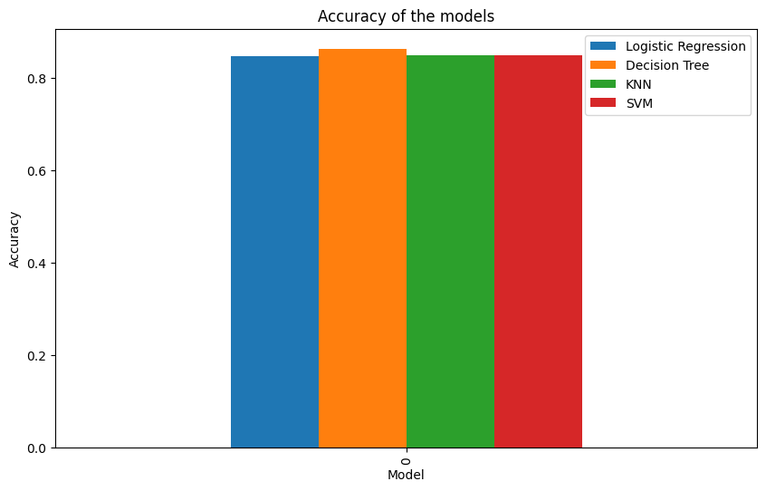
Classification Accuracy
Looking at this bar chart it is possible to see that all models tested performed almost exactly the same, except for decision tree which performed slightly better.

Slide 44

Confusion Matrix
True positives = 12, bottom right corner
False positives = 3, top left corner
True negatives = 3, top right corner
False negatives = 0, bottom left corner

Slide 45
Conclusions
Launch sites are always close to the coast and most launch sites are close to the equator line.
The ML model has a good accuracy when predicting the outcome of a mission.
Launch success is always increasing over time.
Higher payload masses generally means higher success rate.
KSC LC-39A has the highest success rate among launch sites.

Slide 46
Appendix
Github repo : https://github.com/awesomegab/IBM-DS-Capstone
SpaceX API repo: https://github.com/r-spacex/SpaceX-API
OK

Slide 47
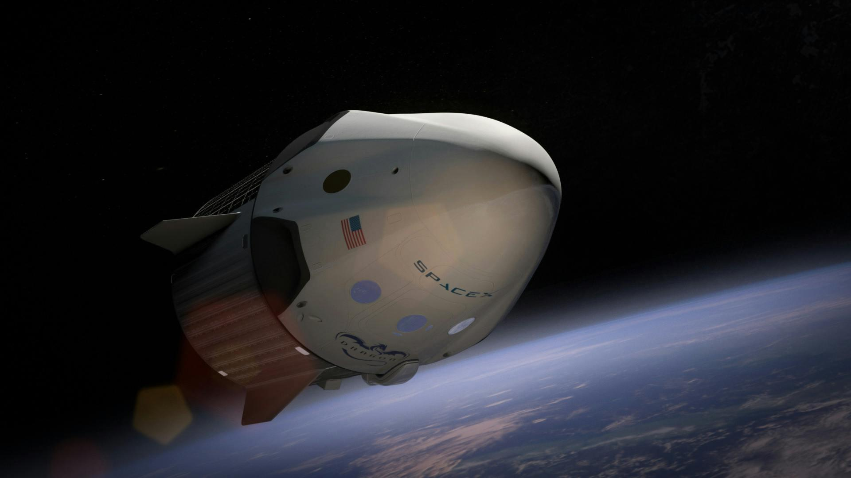
Thank you!

